Slide 1

Year 5 Residential Wednesday March 11th - 13th

Slide 2


Slide 3

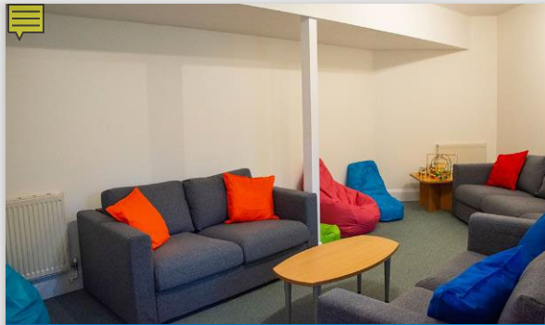
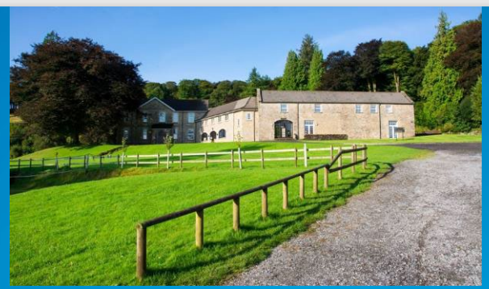
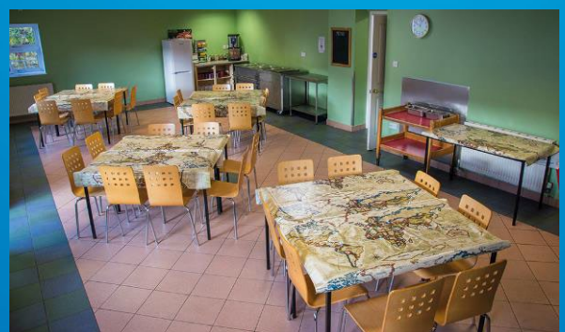
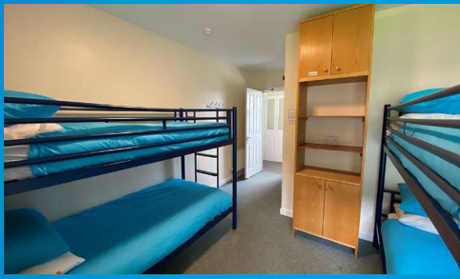

Slide 4
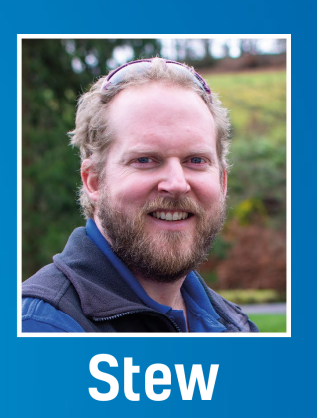
St Minver
Team leader.

Slide 5
Activities
High Ropes
Mission Impossible
Bushcraft
Wilderness Venture

Slide 6
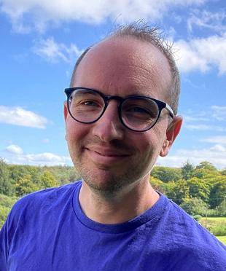
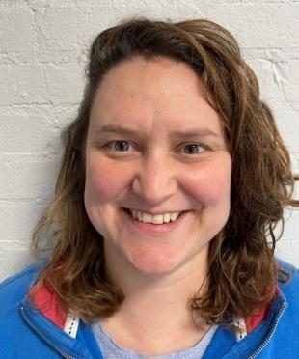
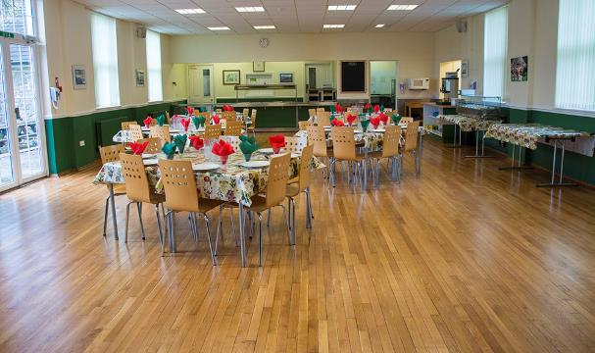
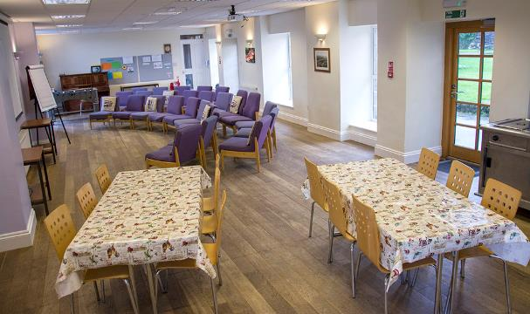
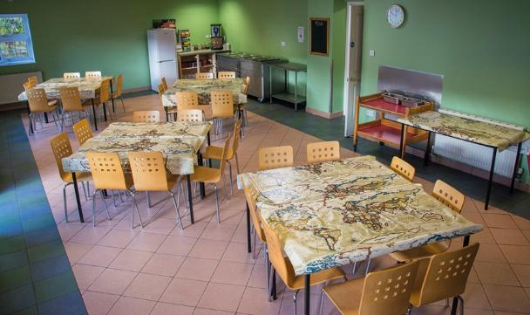
Food and Mealtimes
Breakfast | 8am
Thought for the Day | 9am
Morning Activities | 9.30am
Lunch | 12pm
Afternoon Activities | 1.15pm
Dinner | 5pm
Meet Stew and Rachel!
Notes:
Each morning begins with breakfast at 8am in the dining room, where Chef Stew lays out cereals, toast, jam, marmalade, fruit, yoghurt and fruit juice. Make sure you tell us your dietary needs in advance so we can plan ahead! Lunch is around 12pm, in between your activity sessions, and dinner is at 5pm and always ends with a delicious pudding. Everyone gets stuck in clearing away, washing up the dishes and sweeping the floors. Remember, no one at Heatree is left hungry and there are ALWAYS second helpings, just don’t forget to leave room for supper cake in the evening…

Slide 7
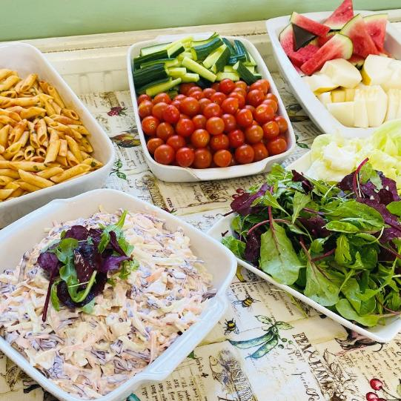
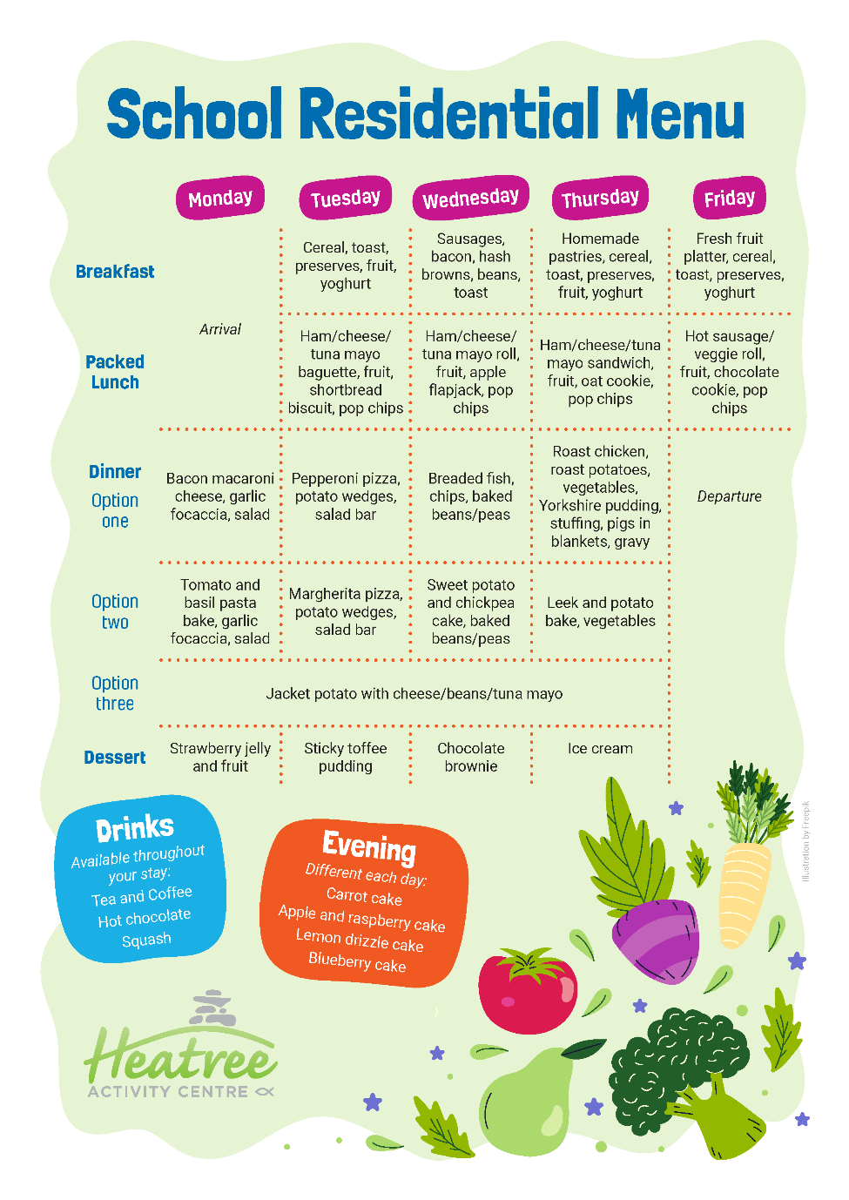
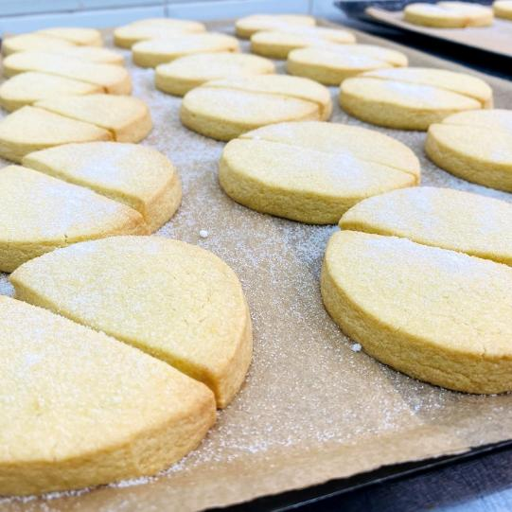
Menu
Notes:
On your first day, when you meet your Lead Instructor, you’ll be asked to choose your dinner option for that day. A copy of the menu is displayed on the corridor noticeboard so you can plan ahead!

Slide 8
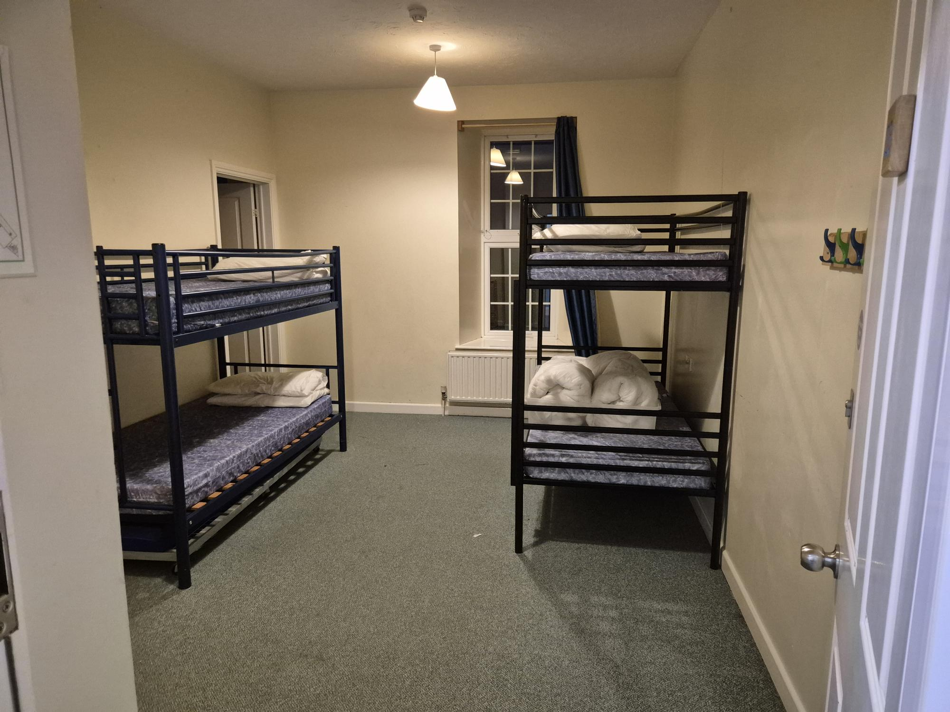
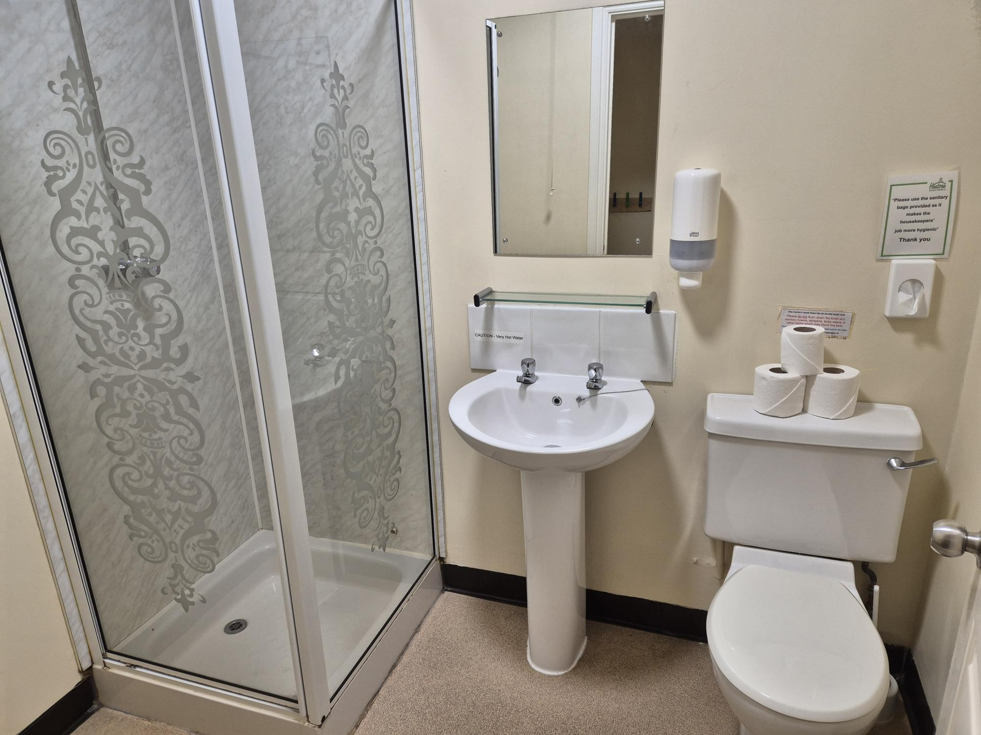
Bedrooms are all ensuite. Bedding (single sheet, pillow with case and a duvet) are provided. Bring a single duvet cover.

